Slide 1

The Internet of Things
Phase I
Prototyping an alarm clock with ARDUINO

Slide 2
The ARDUINO Platform
This video explains the history of the ARDUINO Project which is related with the Processing programming langage ant the Wiring project
Arduino The documentary

Slide 3
Description and purpose
As a previous training and testing stage of the IOT project this smaller and introductory one has been developed.
It is intended to decide which tools to use in the main project and gain practical experience in their use.
In this stage we have analysed and selected:
  Different libraries, some of them not included in the stanadard ARDUINO IDE.
  Various procedures and clients to connect to the serial monitor for debugging an control purposes.

Slide 4
1. General description
We’ll develop an Alarm Clock that will sound and emit light when the alarm time is reached.
The alarm will be active from Monday to Friday at the same time and off on week-ends.
The system will have an internal calendar and clock.
For security reasons, a watchdog mechanism will be implemented.
Initial settings will be set from a PC.

Slide 5
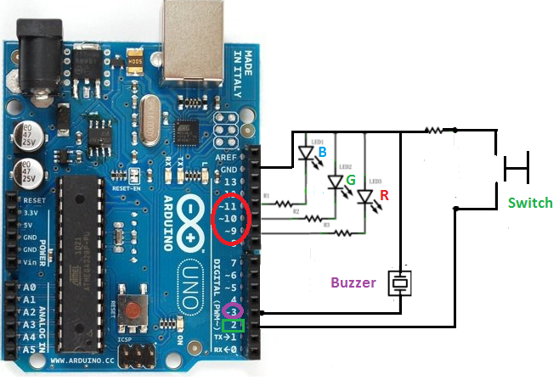

2. Circuit schematic
Only pins 3, 5, 6, 9, 10, and 11 support analogWrite() which will be used to generate PWM AC signals
optional

Slide 6
3. Specs.
First connection or after reset, it will ask for initial settings:
  HH:MM:SS
  DD/MM/AAAA
  Alarm setting from Monday to Friday: HH:MM.
The calendar and clock will be generated from the library Time and will keep the calendar updated and the alarms active.
In any moment it will be posible
  To check calendar and time
  To set new alarm parameters from Monday to Friday.
Once reached the time for alarm, the buzzer will emit a tone and the LED will light in various colors for 1 minute and then after a pause, it will restart and finally will stop after 3 cycles or when the button is pushed.
Acces to the clock will be provided
  Initally, through an USB connection to the serial monitor.
  Later, via Ethernet connection through a web server.

Slide 7
4. Software used
ARDUINO Programming Language and IDE:
  The open source Arduino Software (IDE) runs on Windows, Mac OS X, and Linux. To program sketches we use the Arduino programming language (based on Wiring), and the Arduino Software (IDE), based on Processing.
Apart from the standard ARDUINO IDE libraries (https://www.arduino.cc/en/Reference/Libraries) the following libraries are used too
  Time: provides timekeeping functionality for Arduino. It enabled date and time functionality that can be used with a variety of external time sources with minimum differences required in sketch logic. https://github.com/PaulStoffregen/Time
  Time Alarms: companion to the Time library that makes it easy to perform tasks at specific times or after specific intervals. Tasks scheduled at a particular time of day are called Alarms, tasks scheduled after an interval of time has elapsed are called Timers. https://github.com/PaulStoffregen/TimeAlarms
  TimerOne: counts time and generates interrupts.
  Avr/dwt: “watchdog” library.

Slide 8
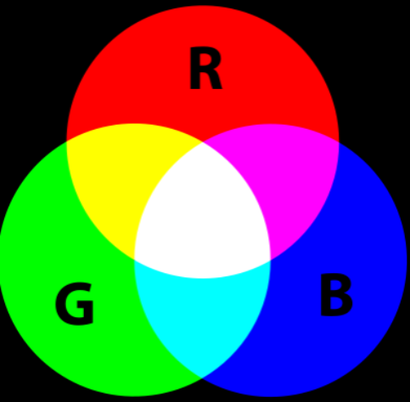
5.0. Components main features (1)
RGB LED: inside the LED package, there are three LEDs, one red, one green and yes, one blue. By controlling the brightness of each of the individual LEDs colors can be mixed.
We can mix any color we like by varying the quantities of red, green and blue light because the human eye has three types of light receptor in it (red, green and blue). Our eye and brain process the amounts of red, green and blue and convert it into a color of the spectrum.

Slide 9
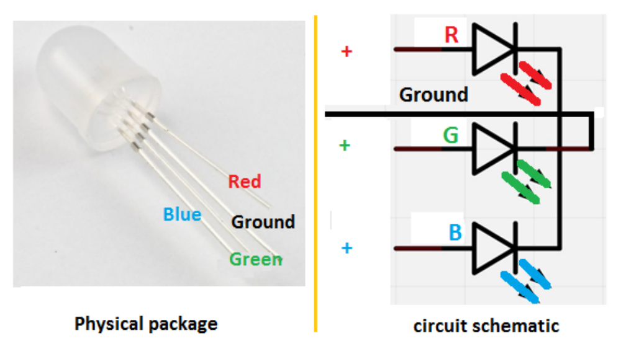
5.0. Components main features (2): RGB LED
Physical description and schematic: the longest pin has to be connected to ground.

Slide 10
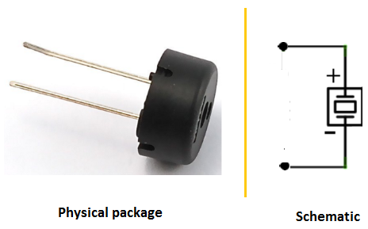
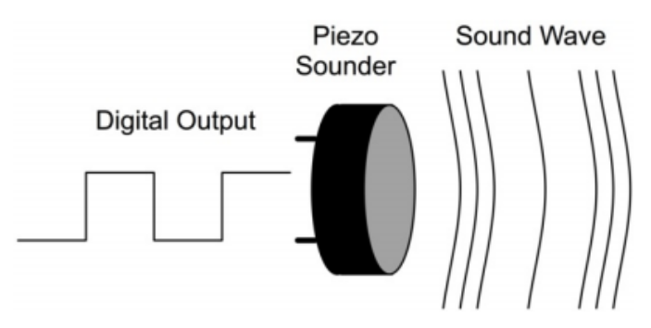
5.0. Components main features (3):
Piezoelectric 5 Volts Buzzer: Applying an AC signal it will emit a sound and can change the frequency.
Sound waves are vibrations in the air pressure. The speed of the vibrations (cycles per second or Hertz) is what makes the pitch of the sound. The higher the frequency of the vibration, the higher the pitch.
PWM signal

Slide 11
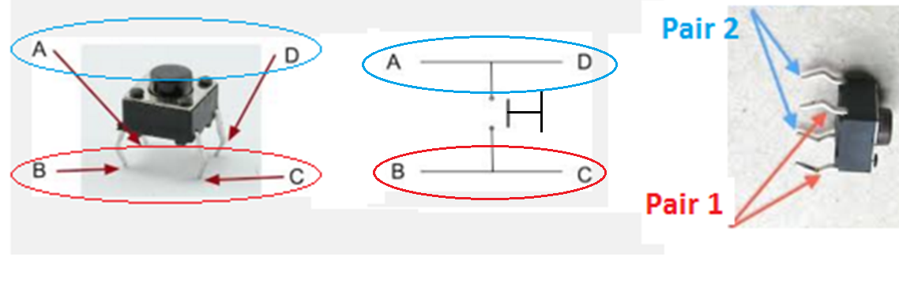
5.0. Components main features (4):
Pulse switch:

Slide 12
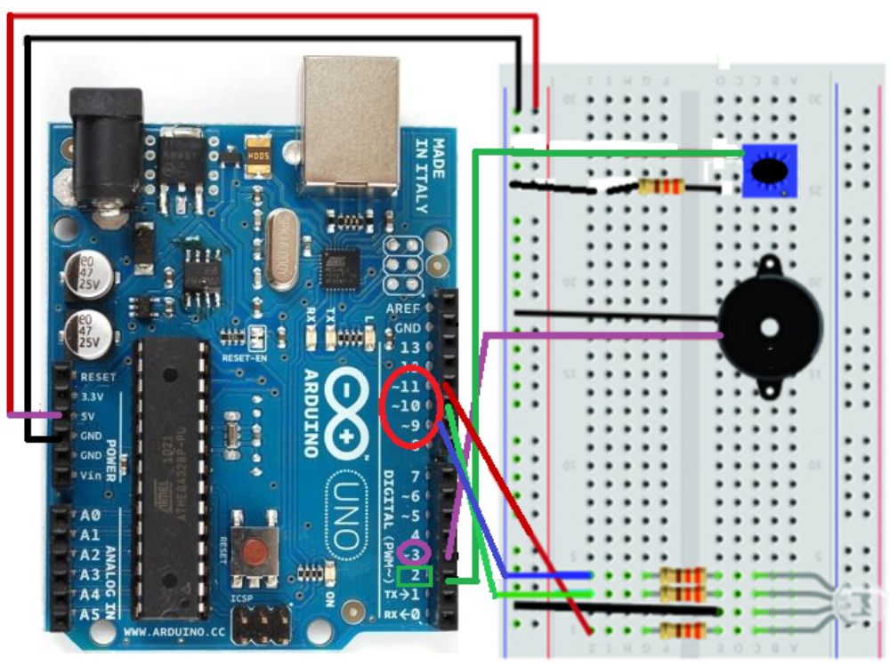
5.1. Hardware (1): No network connection
1 Board ARDUINO UNO
1 RGB LED
4 220 Ω resistors
1 Piezoelectric buzzer
1 Push button
ARDUNO reset button

Slide 13
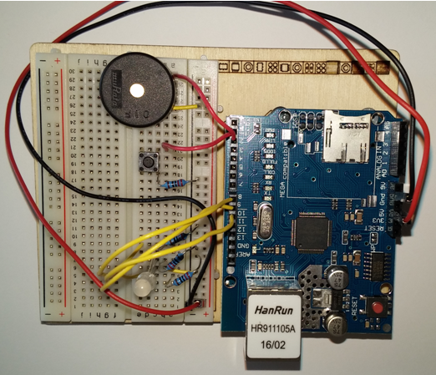
5.1. Hardware (2): Ethernet shield
1 Board ARDUINO UNO
  + Ethernet shield
1 Piezoelectric buzzer
1 Push button
1 RGB LED
4 220 Ω resistors
ARDUINO reset button

Slide 14
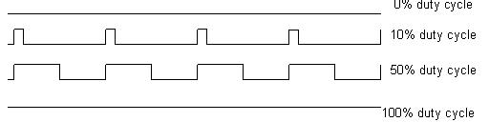
5.2. Review of main libraries and methods used (1)
Basic:
  For Buzzer:
    analogWrite(pin, duty_cycle): 0 (always off) <duty cycle <255 (always on)
  For RGB LED:
    analogWrite(Pin, color): color is defined by the duty cycle
  For pulse switch:
    digitalRead(pin)

Slide 15
5.2. Review of main libraries and methods used (2)
Library Time: Time is a library that provides timekeeping functionality for Arduino. A primary goal is to enable date and time functionality that can be used with a variety of external time sources with minimum differences required in sketch logic.
Library TimeAlarms: The Alarm library is a companion to the Time library that makes it easy to perform tasks at specific times or after specific intervals. Tasks scheduled at a particular time of day are called Alarms, tasks scheduled after an interval of time has elapsed are called Timers. These tasks can be created to continuously repeat or to occur once only. Alarms can be specified to trigger a task repeatedly at a particular day of week and time of day: Alarm.alarmRepeat(dowMonday, 9,15,0, MorningAlarm); This would call the function MorningAlarm()at 9:15:00.

Slide 16
6. Pull-up resistors (1)
CMOS circuits have high impedance. Arduino (Atmega) pins default to inputs, so they don't need to be explicitly declared as inputs with pinMode() when used as inputs. Pins configured this way are in a “high-impedance state”. Input pins make extremely small demands on the circuit that they are sampling, equivalent to a series resistor of 100 MΩ in front of the pin. It is useful to steer an input pin to a known state if no input is present in order to avoid parasitic effects. This can be done by adding a pullup resistor (to +5V), or a pulldown resistor (resistor to ground) on the input.
There are 20 KΩ pullup resistors built into the Atmega chip that can be accessed from software. These built-in pullup resistors are accessed by setting the pinMode() as INPUT_PULLUP.

Slide 17
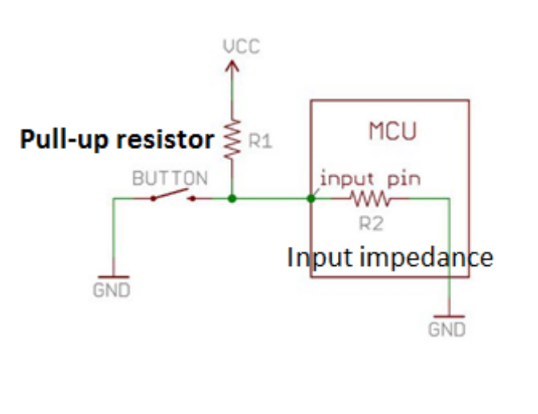
6. Pull-up resistors (2)
In the input pin connected to the switch we will use the ARDUINO’s internal pull-up resistors.
Because the internal pull-up on pin is active and connected to 5V, we read HIGH when the button is open. When the button is closed, the Arduino reads LOW because a connection to ground is completed.
Analog pins: digitalWrite(AI, HIGH);
20 KΩ

Slide 18
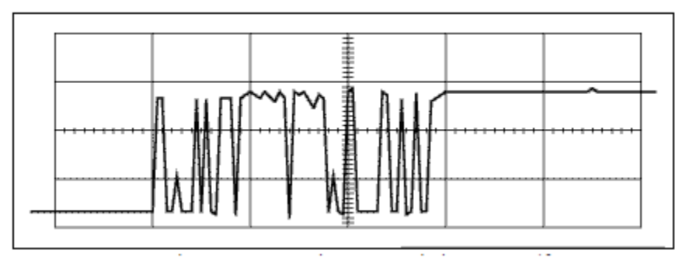
7. Debouncig (1)
When the contacts of any mechanical switch bang together they rebound before settling, causing bounce. Debouncing¹ is the process of removing the bounces to convert the analog signal into ones and zeros.
⁽¹⁾ In general, we shall use a signal filter to process the original sensor data and getting a less volatile easier to digitize signal.
Example of bouncing after pressing a switch

Slide 19
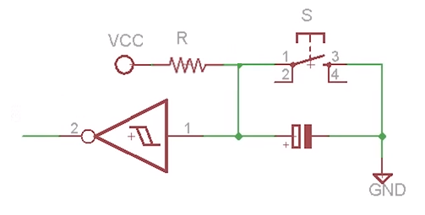
7. Debouncing (2)
Hardware: RC circuit with Schmitt trigger
Software: Bounce2 library

Slide 20
8. Sync.
a Processing sketch which will do this for you. After you've unzipped it,
  look in Time/Examples/Processing/SyncArduinoClock.
Open the sketch in Processing, run it, and then start your Arduino.ç
setSyncProvider( requestSync);

Slide 21
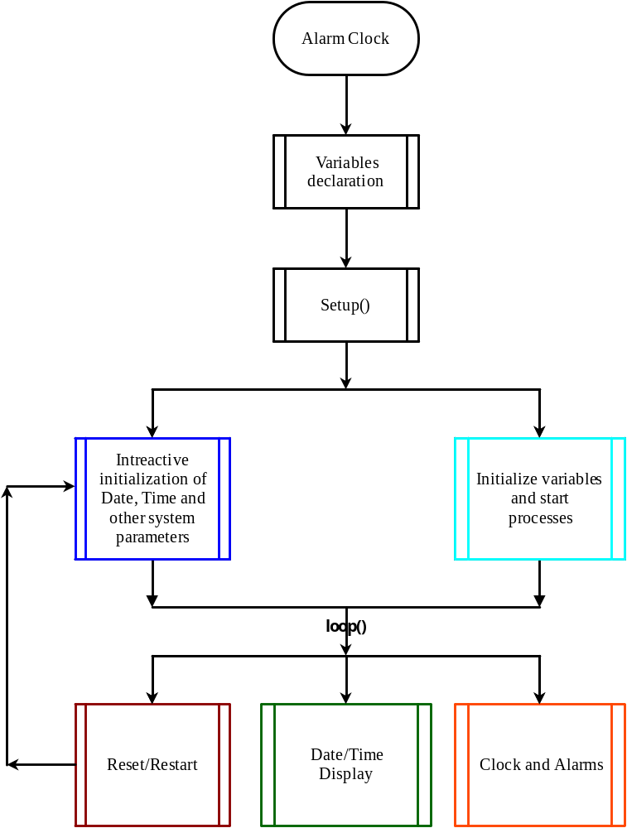
8. Flowchart
It’s necessary to set the date, the time and the alarms.
It is done through the serial monitor.
In case the alarm needs to be reset and we push the button

